Slide 1

DIMENSIONALITY REDUCTION AND
VISUALIZATIONS
PRESENTED BY: KRITI GUPTA (12140940)
COURSE: DATA ANALYTICS AND VISUALISATION
INSTRUCTOR: DR. GAGAN RAJ GUPTA

Slide 2
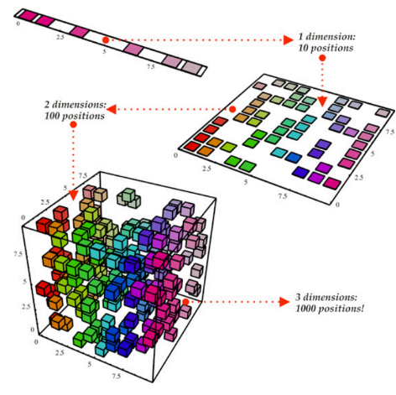
DIMENSIONALITY REDUCTION
  High dimensional data is omnipresent.
  Difficult to visualize and analyze.
  Dimensionality reduction reduces number of
variables in a dataset.
  Eliminates irrelevant or redundant features.
  Extracts the most important features.
  Reduces computational complexity.
  Can lead to loss of information.
  Can cause bias in the model.

Slide 3
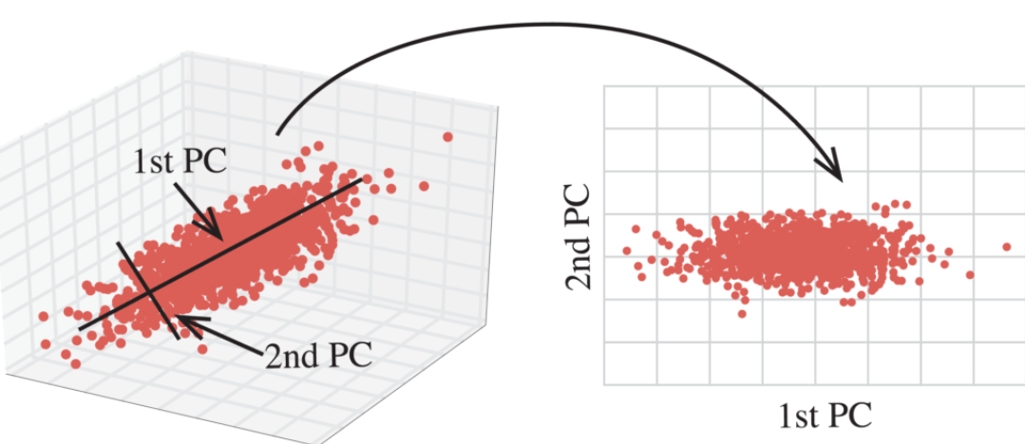
LINEAR DIMENSIONALITY REDUCTION
PRINCIPAL COMPONENT ANALYSIS (PCA):
  Identifies the directions in the data that capture the most variation.
  Projects the data onto these directions
  Resulting projection retains most of the important
information in the original data

Slide 4
NON-LINEAR DIMENSIONALITY REDUCTION
UMAP (UNIFORM MANIFOLD APPROXIMATION AND PROJECTION):
  Creates a weighted graph of the data points.
  Each point is connected to its k nearest neighbors.
  The graph is then used to construct a high-dimensional
simplicial complex that approximates the underlying
manifold of the data.
t-SNE (t-Distributed Stochastic Neighbor Embedding):
  Creates a probability distribution over pairs of
points in the high-dimensional space.
  Creates a similar probability distribution in the
low-dimensional space.
  Minimizes the divergence between the two distributions.

Slide 5
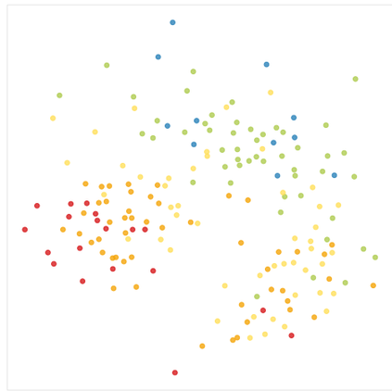
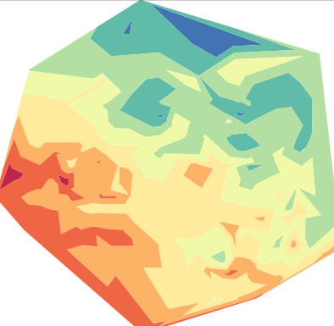
TRADITIONAL TECHNIQUES OF VISUALISATION
COLOR-CODING:
  Assigns each projected data point a color using one of the
original attributes.
  Easy to implement and to comprehend.
  Preserves the pairwise similarities between the data points.
  Suffers from occlusion and visual clutter.
CONTOURS:
  Data is divided into a set of discrete levels or contours.
  Each contour line represents a particular value of the plotted variable.
  Darker colors represent higher values.
  Data points with different attribute values are projected onto the
same position in 2D space

Slide 6
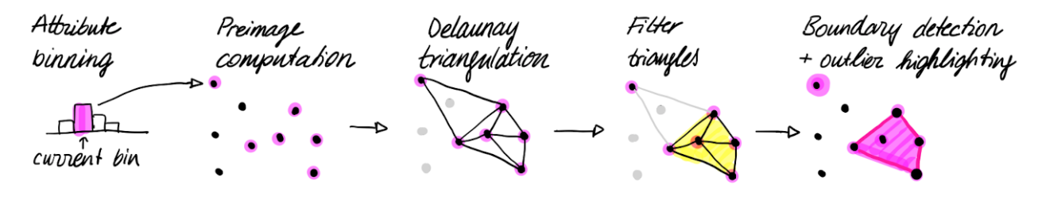
RANGESETS
  Combines strengths of traditional visualization techniques.
  Use geometric contours to group similar value data points.
  For categorical attributes a contour is drawn per category.
  For continuous attributes a contour is drawn per bin.
  The algorithm consists of 5 steps-

Slide 7
NON-CONVEX HULLS:
  Given a set S of n points.
  Find a hull that tightly encloses points of S.
  α-hulls can be computed efficiently and allow for filtering of outliers.
  It is the intersection of all closed complements of discs with radius −1/α that contain all the points of S.
  They can be computed efficiently by Delaunay Triangulation.
  Excludes triangles containing an edge whose length exceeds given threshold ε.
  ε controls the “tightness” of the computed contour.

Slide 8
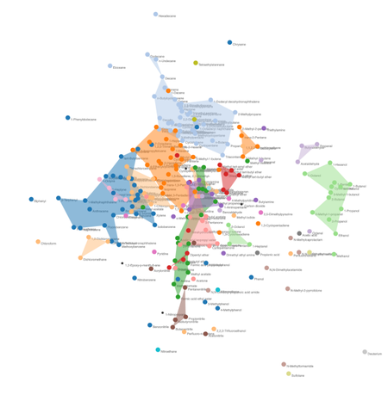
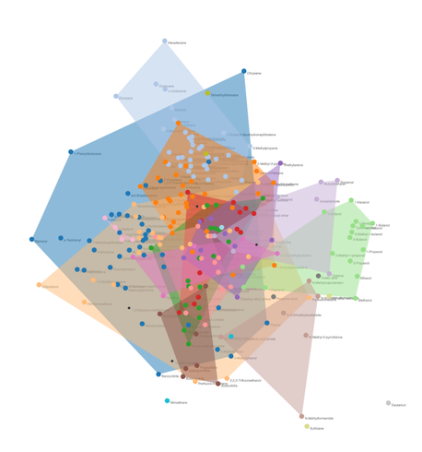
TOPOLOGICAL FILTRATION TO CONTROL ε:
  Increasing the threshold ε can only add triangles to the non-convex hull.
  For ε = 0 no contour is created and all data points are outliers.
  Increasing ε-values many small contours form which eventually merge to larger more stable contours
  For ε = 1, there is only one contour and the threshold parameter only controls the number of outliers.
For ε=0.75
For ε=10

Slide 9
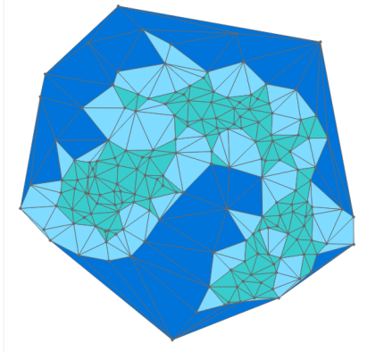
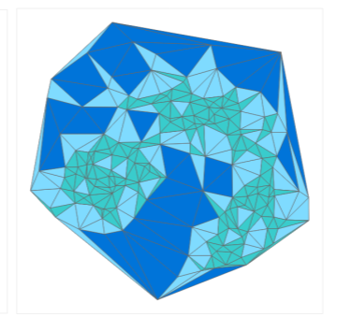
DISCUSSION OF TRIANGLE FILTER CRITERIA:
  Three criteria used for triangle filtration.
  Edge Length- Used for filtration in Non-Convex Hulls algorithm.
  Inner Angles- Delaunay triangulation creates an angle optimal triangulation.
  Out of all triangulations, one with largest smallest angle chosen.
  This avoids long, spiky triangles.
  Triangle Area- Excludes large triangles that cover space without additional points inside the triangle.
Edge-length based filtration
Area based filtration

Slide 10
SCALABILITY AND STABILITY:
  Algebaric topology algorithms are computationally expensive.
  Rangesets very quick for up to 1000 data points.
  Acceptable waiting times up to 5000 data points.(about 7 secs)
  For more datapoints we downsample the dataset or precompute rangesets.
VISUAL ENCODING:
  Augment scatter-plots with polygons and color-coded glyphs.
  Contour for each bin is a filled transparent polygon.
  Custom contours (gray outline) can be added to highlight a selected group of points
  Outliers are plotted on top of the contours

